Slide 1
Hockey RAG Model
By: Tim, Jacob, Dhun

Slide 2
Table of Contents
Motivation
RAG Background
Retriever
Generator
Results
Future Work

Slide 3

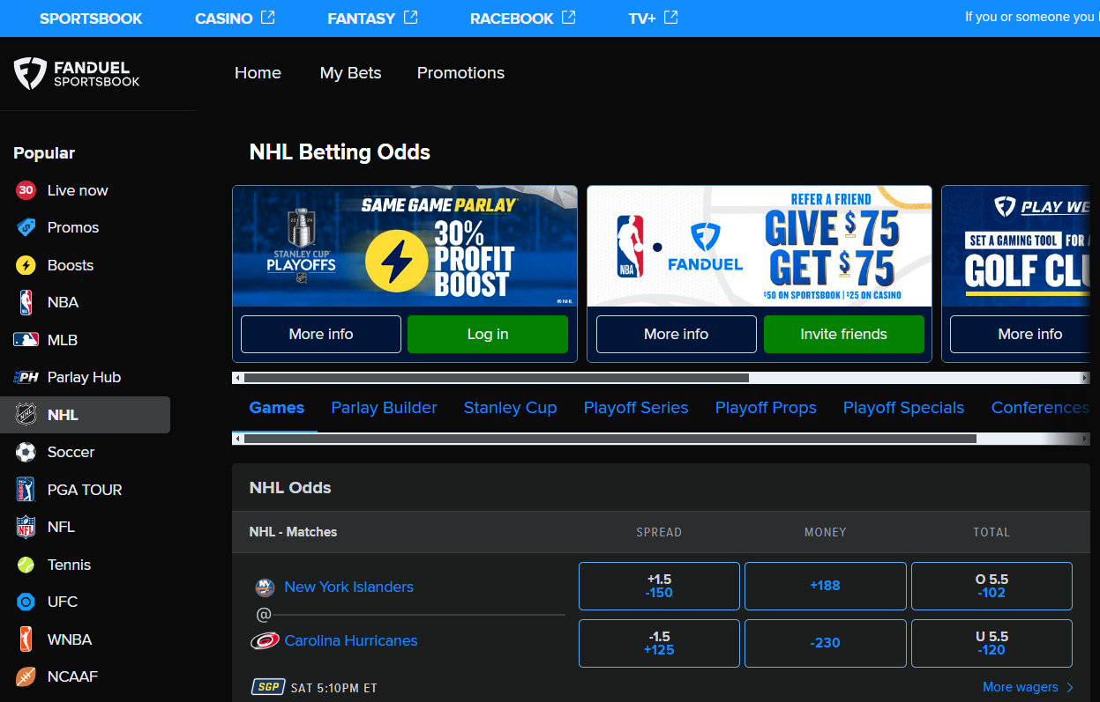

Motivation
Notes:
Dhun

Slide 4
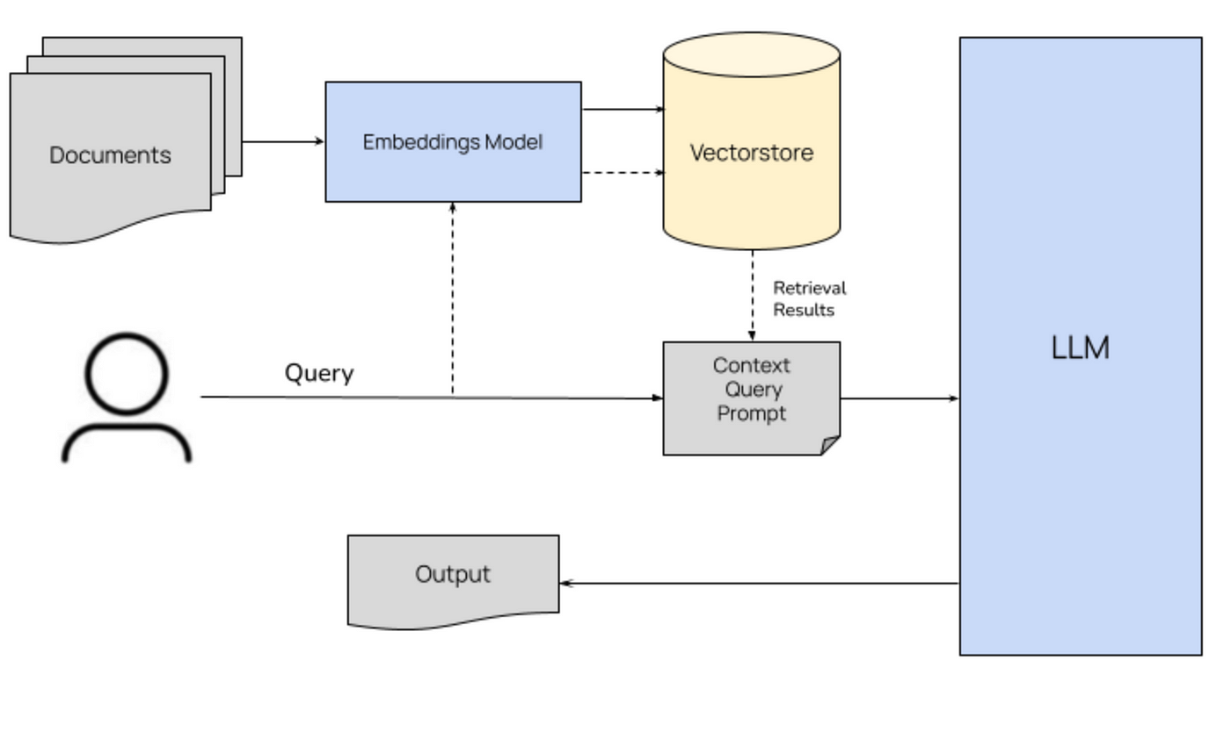
How does a RAG work?
-> Retrieve
-> Augment
-> Generate
Image source: [1]
Notes:
Jacob

Slide 5
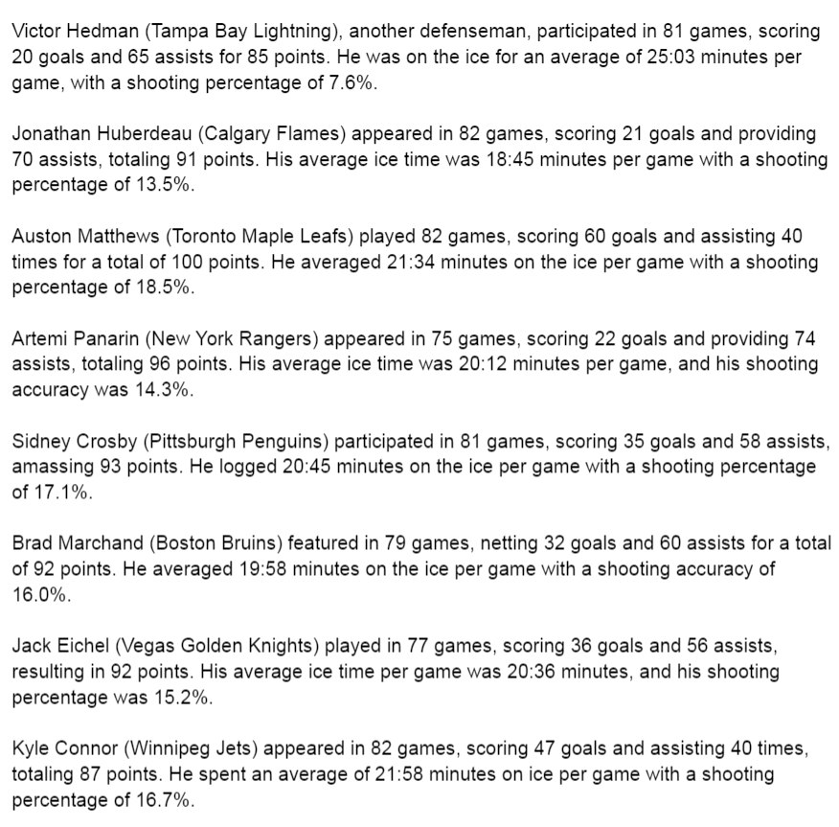
External Knowledge Base
Purpose: The external knowledge base contains factually correct data that can be updated quickly without retraining any models. This is usually new information that a pre-trained LLM was not trained on.
Implementation: Our knowledge base consist of over 50 of top NHL players statistics for the 2023 season. This data is stored in a pdf file in full sentences.
Notes:
Tim

Slide 6
Retriever
Purpose: Identify and gather relevant information in the external knowledge base that is related to the user query.
Process: Compares the numeric embeddings of the users query and the external knowledge base. These numeric embeddings are generated by pre-trained Microsoft model, all-mpnet-base-v2.
Execution: When a query is received, the embedded query is compared against the embedded knowledge base. Similarity scores are calculated for each embedded document in the knowledge base and the highest n ranking documents are passed to the generative LLM as context.
Notes:
Jacob

Slide 7
Generator
Purpose: Generate a coherent response to the query while considering relevant context provided by the retriever.
Process: Generates texts using the gemma-7b, this is a pre-trained LLM from ‘transformers’ library. A smaller gemma-2b model was also tested, but proved to be not powerful enough.
Execution: A prompt containing the user query and relevant context from the retriever is provided to the generator. The generator will then generate a text response to the query.
Notes:
Jacob

Slide 8

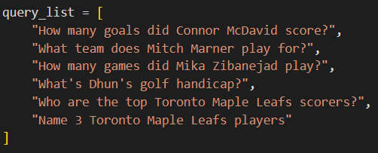
Experimental Results
Prompt in Base LLM
Retriever + Gemma 2b Prompt
Notes:
Dhun

Slide 9
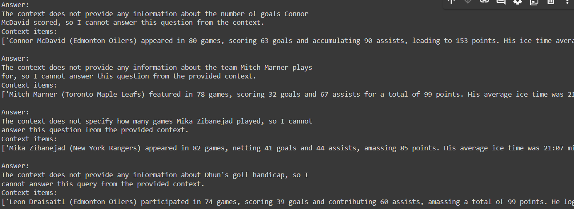
Results Cont’d
Retriever + Gemma 2b Output
Notes:
Dhun

Slide 10
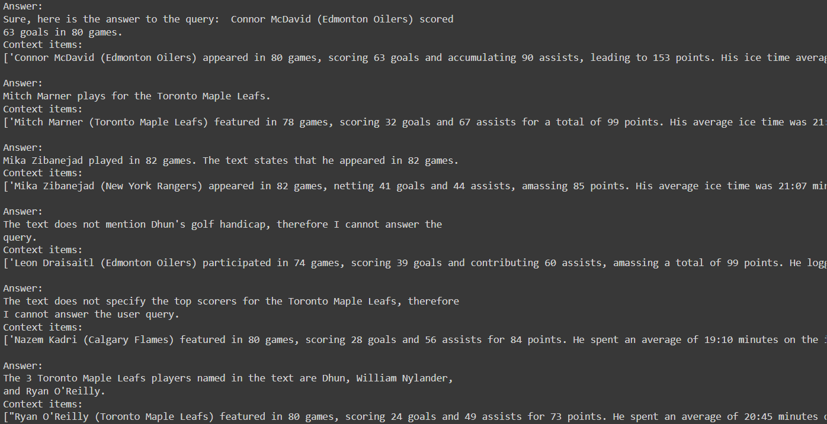
Results Cont’d
Retriever + Gemma 7b Output
Notes:
Dhun

Slide 11
Future Work
Improve retriever (try another evaluation criteria)
Try different prompt formats
Try a different LLM
Fine-tuning pre-trained LLM
Notes:
Tim

Slide 12
References
[1] Stackademic. (April 19, 2024). Image title or description. Retrieved from https://blog.stackademic.com/mastering-retrieval-augmented-generation-rag-architecture-unleash-the-power-of-large-language-a1d2be5f348c
[2] Bourke, D. (n.d.). Simple Local Rag. GitHub. Retrieved April 21st, 2024, from https://github.com/mrdbourke/simple-local-rag

